Slide 1

Evaluating SDMs:
A Critical Reading
The Wallace team
Slide deck lead by Andrea Paz and Jamie Kass

Slide 2
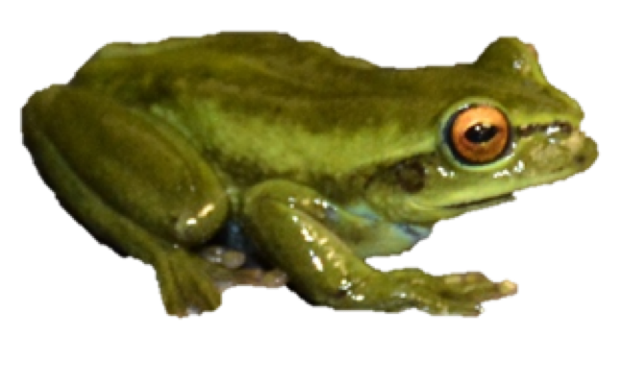
The data
      An example: we want to know the physiological limits of a frog and we use environmental layers at 25 km resolution
Appropriate?
Notes:
Image credit: A. Paz.

Slide 3
The data
      There are many sources of environmental and occurrence data
      Are they appropriate for our:
            current distribution?
            physiological tolerances?
            niche preferences?
            niche differences between species?
            distributional changes over space and/or time?

Slide 4
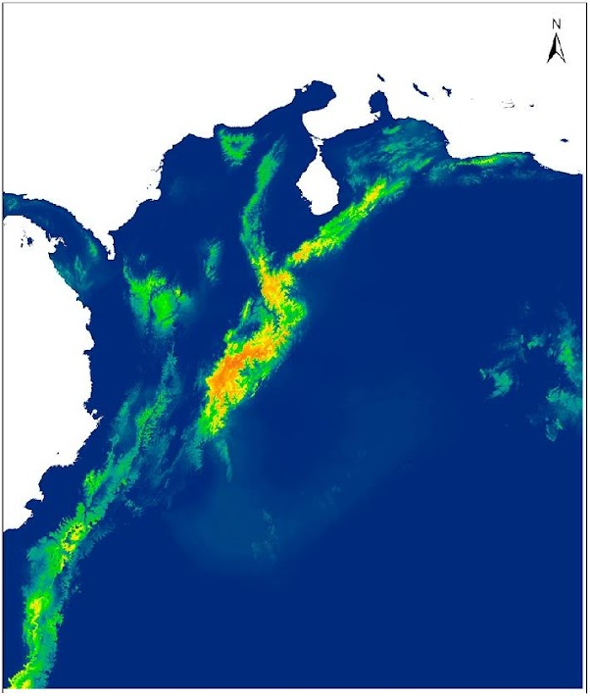
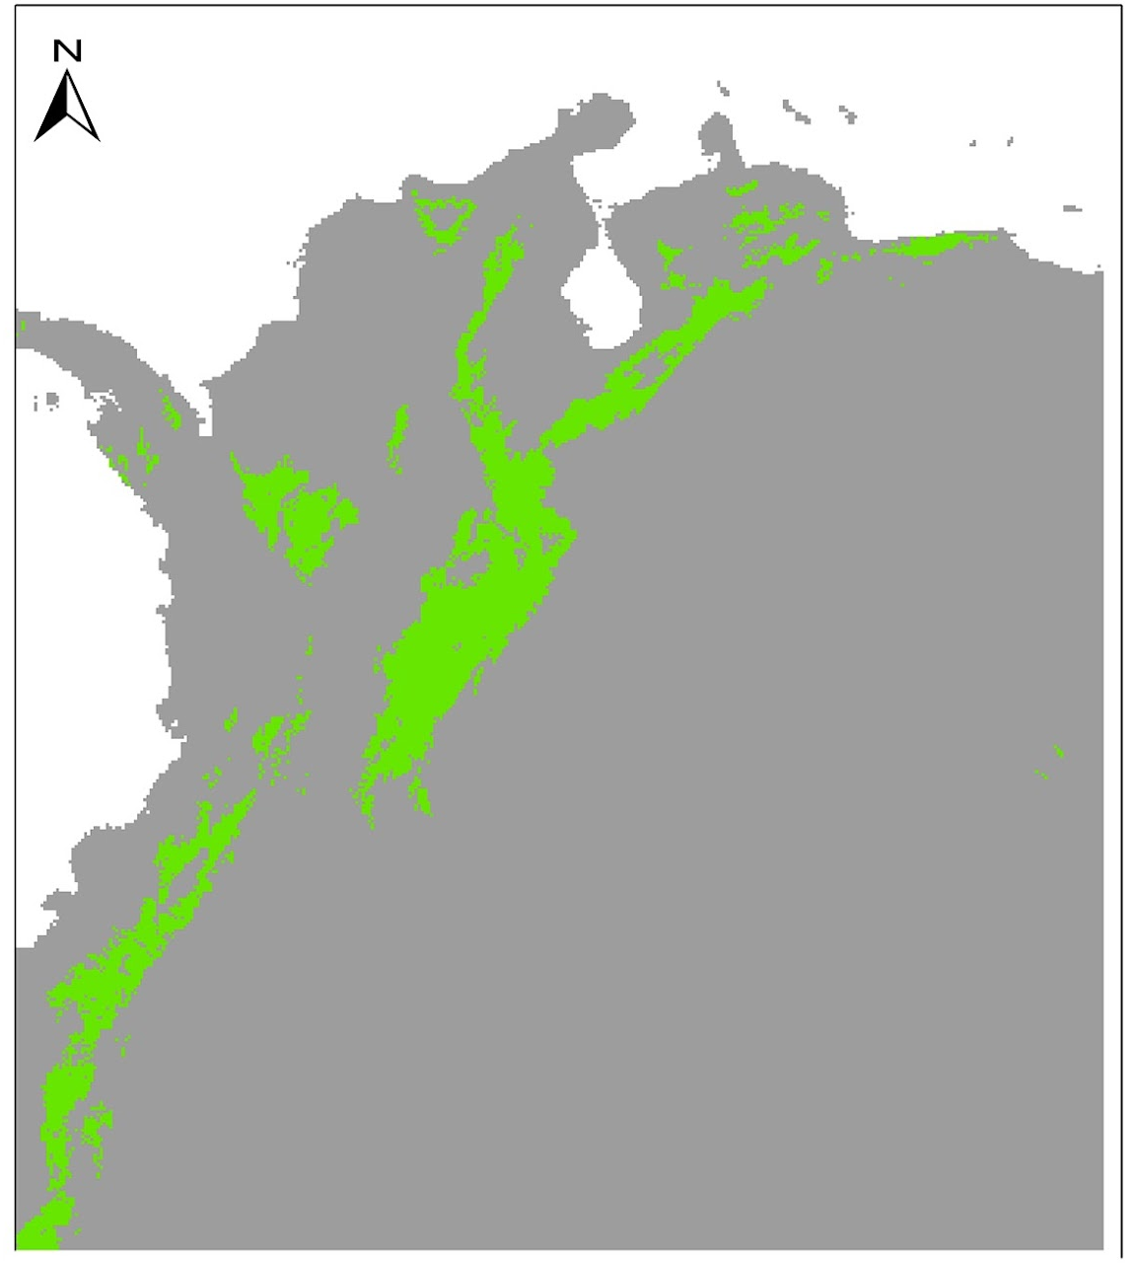
Evaluating models
Dendropsophus molitor
Is this a good or a bad model?
Notes:
Image credit: Adapted by A. Paz from Paz, A., A. Gonzalez, and A.J. Crawford. 2019. Testing effects of Pleistocene climate change on the altitudinal and horizontal distributions of frogs from the Colombian Andes: a species distribution modeling approach. Frontiers of biogeography 11:e37055.

Slide 5
Evaluating models from organismal expertise
Dendropsophus molitor
Notes:
Paz, A., A. Gonzalez, and A.J. Crawford. 2019. Testing effects of Pleistocene climate change on the altitudinal and horizontal distributions of frogs from the Colombian Andes: a species distribution modeling approach. Frontiers of biogeography 11:e37055.

Slide 6
The models: Data & congruence with the questions
Biodiversity Data:
Only presences from GBIF
About 15 observations
Cleaned?
Environmental data
Worldclim
Question:
Potential past distribution
Algorithm:
Maxent
Tuned? Yes
Threshold:
10 percentile
Dendropsophus molitor
Notes:
Image credit: Adapted by A. Paz from Paz, A., A. Gonzalez, and A.J. Crawford. 2019. Testing effects of Pleistocene climate change on the altitudinal and horizontal distributions of frogs from the Colombian Andes: a species distribution modeling approach. Frontiers of biogeography 11:e37055.

Slide 7
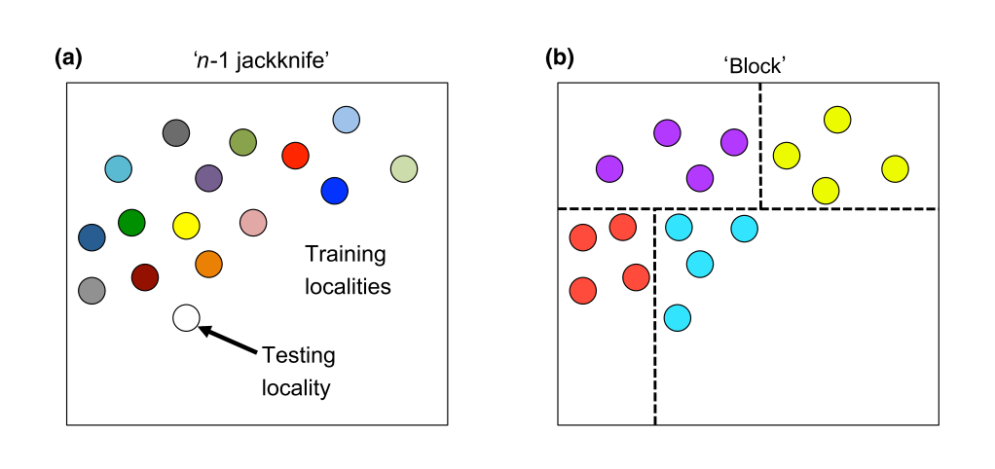
The models: statistical evaluation
To compute evaluation statistics we need test data
  Ideally these would be independent
  But we want to use as much data for modeling as we can
We can partition data into groups for cross-validation
Muscarella et al. 2014
Notes:
Image credit: Muscarella, R., P.J. Galante, M. Soley-Guardia, R.A. Boria, J.M. Kass, M. Uriarte, and R.A. Anderson. 2014. ENMeval: An R package for conducting spatially independent evaluations and estimating optimal model complexity for Maxent ecological niche models, Methods in Ecology and Evolution 5(11):1198-1205.

Slide 8
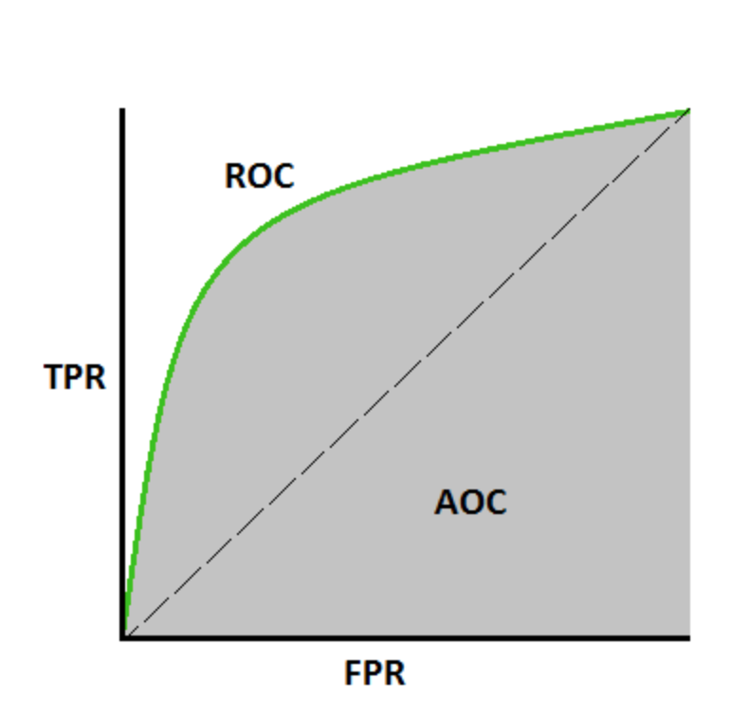
The models: statistical evaluation
Training AUC= 0.87
So does that mean this a good model?
True Positives
Dendropsophus molitor
1- False positives
Notes:
Image credits: Adapted by A. Paz from Paz, A., A. Gonzalez, and A.J. Crawford. 2019. Testing effects of Pleistocene climate change on the altitudinal and horizontal distributions of frogs from the Colombian Andes: a species distribution modeling approach. Frontiers of biogeography 11:e37055.

Slide 9
The models: statistical evaluation
Training AUC= 0.87
So does that mean this a good model?
We are predicting data the model was trained on
Better test of performance to predict data the model does not know
Dendropsophus molitor
Notes:
Image credit: Adapted by A. Paz from Paz, A., A. Gonzalez, and A.J. Crawford. 2019. Testing effects of Pleistocene climate change on the altitudinal and horizontal distributions of frogs from the Colombian Andes: a species distribution modeling approach. Frontiers of biogeography 11:e37055.

Slide 10
The models: statistical evaluation
Training AUC= 0.87
So does that mean this a good model?
How do we know?
no absences…
True Positives
Dendropsophus molitor
1- False positives
Notes:
Image credit: Adapted by A. Paz from Paz, A., A. Gonzalez, and A.J. Crawford. 2019. Testing effects of Pleistocene climate change on the altitudinal and horizontal distributions of frogs from the Colombian Andes: a species distribution modeling approach. Frontiers of biogeography 11:e37055.

Slide 11
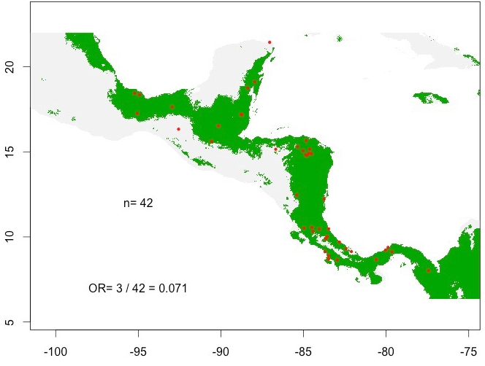
The models: statistical evaluation
Omission rates
OR_{min}= 0.01
OR₁₀=0.071
Notes:
Image credit: A. Paz.

Slide 12
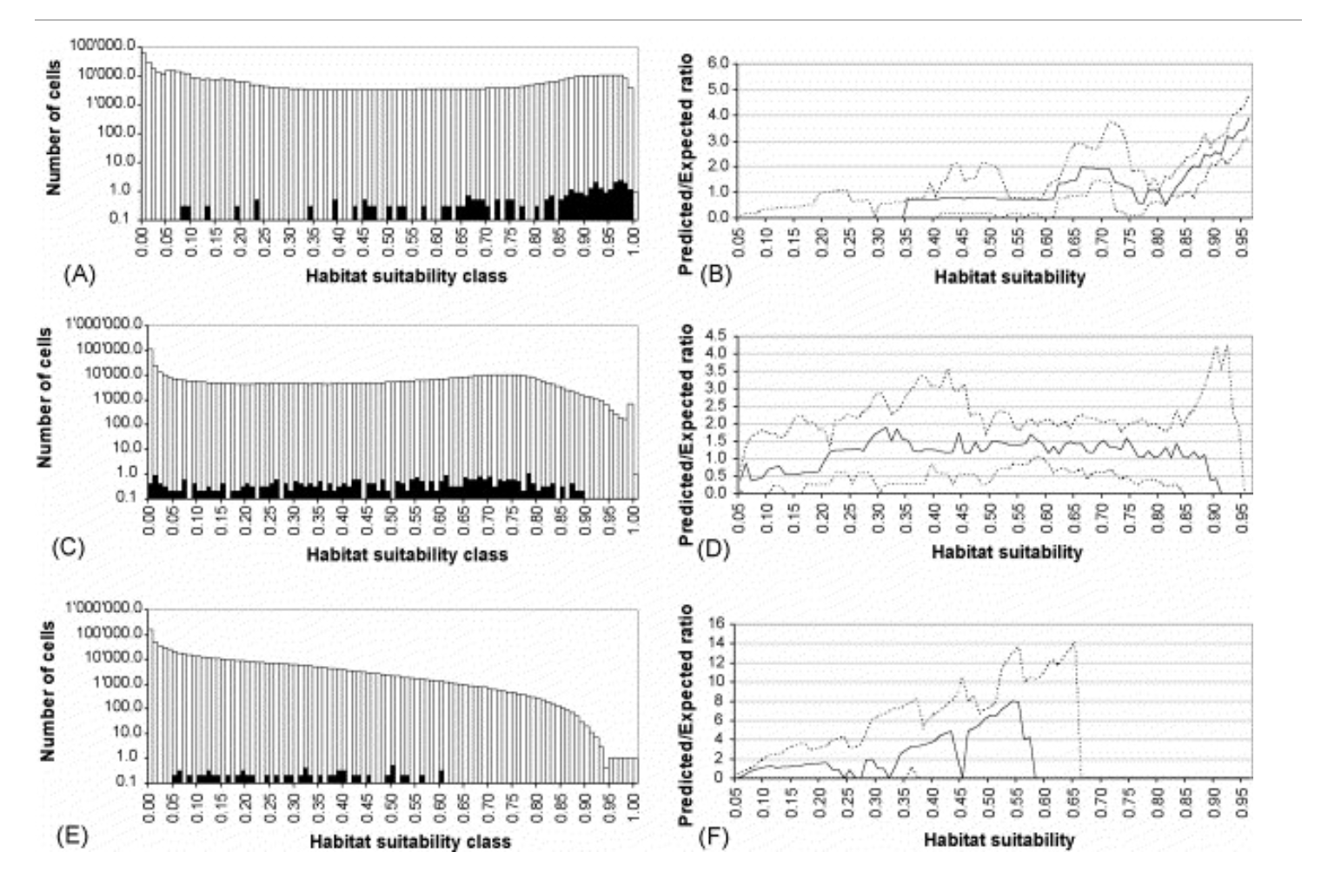
The models: statistical evaluation
Continuous Boyce Index: made for presence-only data
good model
random model
bad model
Hirzel et al. 2006
Notes:
Image credit: Hirzel et al. 2006

Slide 13
The models: statistical evaluation
Information criteria:
AICc= 450
Comparative measure
Only makes sense when comparing models built with same data but different predictors/settings
Maximizes likelihood while minimizing complexity
Dendropsophus molitor
Notes:
Image credit: Adapted by A. Paz from Paz, A., A. Gonzalez, and A.J. Crawford. 2019. Testing effects of Pleistocene climate change on the altitudinal and horizontal distributions of frogs from the Colombian Andes: a species distribution modeling approach. Frontiers of biogeography 11:e37055.

Slide 14
Was the model good or bad?
Overestimates the real distribution
But question was about areas of potential distribution (present and past)
Data appropriate or at least best available for the question (assuming they were cleaned!)
Not all appropriate statistics were computed but values were ok for AUC and OR but no models are presented for comparison was there a better one?
Dendropsophus molitor
Notes:
Image credits: Adapted by A. Paz from Paz, A., A. Gonzalez, and A.J. Crawford. 2019. Testing effects of Pleistocene climate change on the altitudinal and horizontal distributions of frogs from the Colombian Andes: a species distribution modeling approach. Frontiers of biogeography 11:e37055.

Slide 15
Was the model good or bad?
Good performance statistics
Should compare to other models to find optimal complexity
Dendropsophus molitor
Notes:
Image credit: Adapted by A. Paz from Paz, A., A. Gonzalez, and A.J. Crawford. 2019. Testing effects of Pleistocene climate change on the altitudinal and horizontal distributions of frogs from the Colombian Andes: a species distribution modeling approach. Frontiers of biogeography 11:e37055.

Slide 16
Evaluating models
These were only some considerations
Important whether data, algorithms and statistics are appropriate for the question. There is no silver bullet!
There are other statistics for SDMs—do some research to interpret them properly and make sure they are appropriate for your study, and consider using multiple statistics
Always remember: “Garbage in, Garbage out”. Just because you can get a map does not mean it is correct, trustworthy, or even appropriate

